Slide 1
Pattern Matching
COMP171
Spring 2009

Slide 2
Pattern Matching
Given a text string T[0..n-1] and a pattern P[0..m-1], find all occurrences of the pattern within the text.
Example: T = 000010001010001 and P = 0001:
  first occurrence starts at T[1].
  second occurrence starts at T[5].
  third occurrence starts at T[11].

Slide 3
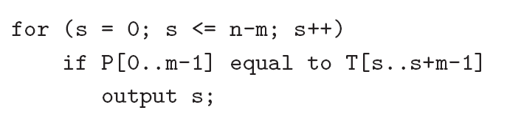
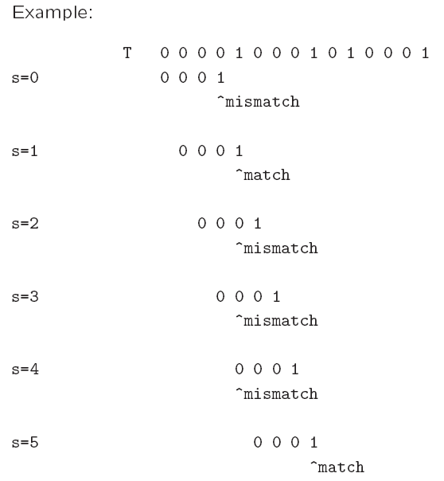
Naïve algorithm
Worst-case running time = O(nm).

Slide 4
Can we do it better?
The naïve algo is O(mn) in the worst case
But we do have linear algorithm (optional):
  Boyer-Moore
  Knuth-Morris-Pratt
  Finite automata
Using idea of ‘hashing’! Robin-Karp algorithm

Slide 5
Boyer-Moore Algorithm
Basic idea is simple.
We match the pattern P against substrings in the text string T from right to left.
We align the pattern with the beginning of the text string. Compare the characters starting from the rightmost character of the pattern. If fail, shift the pattern to the right, by how far?

Slide 6
Rabin-Karp Algorithm
Key idea:
  Think of the pattern P[0..m-1] as a key, transform it into an equivalent integer p.
  Similarly, we transform substrings in the text string T[] into integers.
    For s=0,1,…,n-m, transform T[s..s+m-1] to an equivalent integer t_{s}.
  The pattern occurs at position s if and only if p=t_{s}.
If we compute p and t_{s} quickly, then the pattern matching problem is reduced to comparing p with n-m+1 integers.

Slide 7
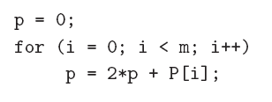
Rabin-Karp Algorithm
How to compute p?
  p = 2^{m-1} P[0] + 2^{m-2} P[1] + … + 2 P[m-2] + P[m-1]
Using Horner’s rule
This takes O(m) time, assuming each arithmetic operation can be done in O(1) time.

Slide 8
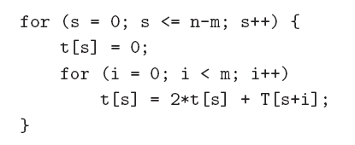
Rabin-Karp Algorithm
Similarly, to compute the (n-m+1) integers t_{s} from the text string.
This takes O((n – m + 1) m) time, assuming that each arithmetic operation can be done in O(1) time.
This is a bit time-consuming.

Slide 9
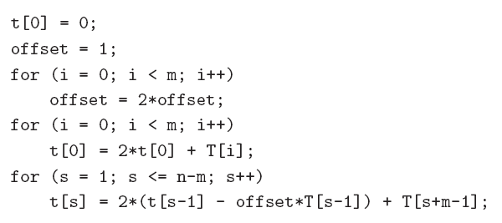
Rabin-Karp Algorithm
A better method to compute the integers incrementally using previous result:
compute offset = 2^{m}
Horner’s rule to compute t₀
t_{S-1}
t_{S}
This takes O(n+m) time, assuming that each arithmetic operation can be done in O(1) time.

Slide 10
Problem
The problem with the previous strategy is that when m is large, it is unreasonable to assume that each arithmetic operation can be done in O(1) time.
  In fact, given a very long integer, we may not even be able to use the default integer type to represent it.
Therefore, we will use modulo arithmetic. Let q be a prime number so that 2q can be stored in one computer word.
  This makes sure that all computations can be done using single-precision arithmetic.

Slide 11
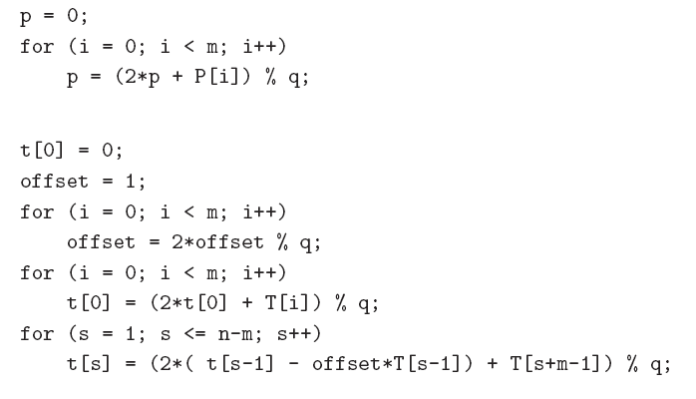
Compute equivalent integer for pattern
O(m)
O(n+m)

Slide 12
Once we use the modulo arithmetic, when p=t_{s} for some s, we can no longer be sure that P[0 .. m-1] is equal to T[s .. s+ m -1 ].
Therefore, after the equality test p = t_{s}, we should compare P[0..m-1] with T[s..s+m-1] character by character to ensure that we really have a match.
So the worst-case running time becomes O(nm), but it avoids a lot of unnecessary string matchings in practice.

Slide 13
A spell checker with hashing
Start by reading in words from a dictionary file named dictionary. The words in this dictionary
file will be listed one per line, sorted alphabetically. Store each word in a hash table, using
chaining to resolve collisions. Start with a table size of roughly 4K entries (the table size should
be prime). If necessary, rehash to a larger table size to keep the load factor less than 1.0.
After hashing each word in the dictionary file, read in the user-specified text file and check it for
spelling errors by looking up each word in the hash table. A word is defined as a string of letters
(possibly containing single quotes), separated by white space and/or punctuation marks. If a word
cannot be found in the hash table, it represents a possible misspelling.

